Slide 1

Software Quality assurance (SQA)
Chapter 1- Lec1
Introduction and Definitions

Slide 2
What is software quality?
What is software?
Definition of quality
Software errors, faults and failures
Classification of the causes of software errors
Software quality – definition
Software quality assurance – definition and objectives
Software quality assurance and software engineering

Slide 3
Software - IEEE definition
Software is:
Computer programs, procedures, and possibly associated documentation and data pertaining to the operation of a computer system.

Slide 4


What is quality ?
Quality popular view:
– Something “good” but not quantifiable
– Something luxury and classy
Quality professional view:
– Conformance to requirement
(Crosby, 1979)
The requirements are clearly stated and the product must conform to it
Any deviation from the requirements is regarded as a defect
A good quality product contains fewer defects
– Fitness for use (Juran, 1970):
Fit to user expectations: meet user’s needs
A good quality product provides better user satisfaction

Slide 5

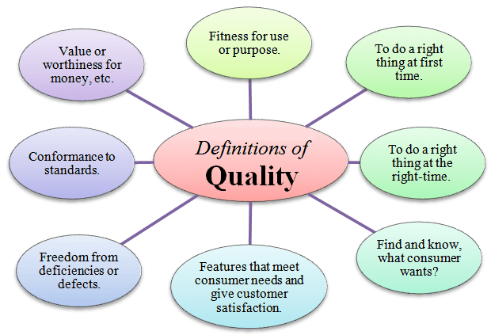
What you see of high quality others do not see it like that.
It depends on your requirements.
For example a university perfect registration system is not necessarily suitable to a schools.

Slide 6

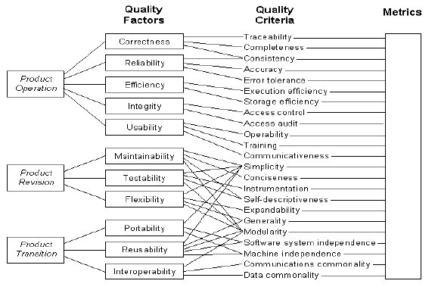
ISO Definition of Quality
ISO 8402 definition
of QUALITY:
The totality of features and characteristics of a product or a service that bear on its ability to satisfy stated or implied needs
ISO 9216 Model:
Quality characteristics
Functionality
Reliability
Usability
Efficiency
Maintainability
Portability

Slide 7

Other definition and concept
• Four Absolutes:
– Quality Means Conformance to Requirements. Both functional and non functional
- Quality Comes from Prevention
- Quality is never ending improvement
– Quality is Zero Defects

Slide 8
Benefits of software quality
Decreased number of defects and errors in software
Less rework as a result of less software defects
Reduced development and maintenance cost
Increased software reliability
Increased customer satisfaction
Happier software practitioners

Slide 9
Software Engineers and quality
Software engineers strive to control the
process applied: What is the best process (i.e SDLC) to be used for the development of software
resources expended: Make sure software development is finished in expected time and also using the estimated budget
end product quality attributes: Make sure that the software it self is of a high quality and contains all features and requirements (functional and non functional)

Slide 10
The nine causes of software errors are:
Faulty requirements definition
Client-developer communication failures
Deliberate deviations from software requirements
Logical design errors
Coding errors
Non-compliance with documentation and coding instructions
Shortcomings of the testing process
User interface and procedure errors
Documentation errors

Slide 11
Software quality - IEEE definition
Software quality is:
(1) The degree to which a system, component, or process meets specified requirements.
(2) The degree to which a system, component, or process meets customer or user needs or expectations.

Slide 12
SQA - expanded definition
Software quality assurance is:
A systematic, planned set of actions necessary to provide adequate confidence that the software development process or the maintenance process of a software system product conforms to established functional technical requirements as well as with the managerial requirements of keeping the schedule and operating within the budgetary confines.

Slide 13
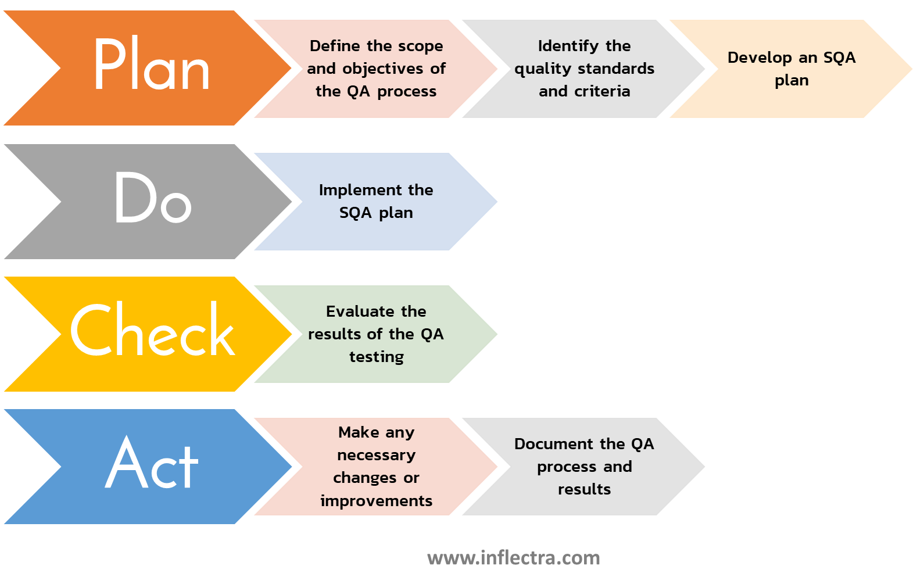

Slide 14
The objectives of SQA activities
in software development
(1) Assuring an acceptable level of confidence that the software will conform to functional technical requirements.
(2) Assuring an acceptable level of confidence that the software will conform to managerial scheduling and budgetary requirements.
(3) Initiation and management of activities for the improvement and greater efficiency of software development and SQA activities.

Slide 15
Software quality perspectives
Software quality can be seen from different perspectives:
- Customer : Complete requirements (Functional and non functional)
- Project manager: Cost and schedule
- Maintenance engineer: Detection and correction times

Slide 16
Software quality should be considered in:
Infrastructure and tools
Staff
Contract
SDLC ( Requirements, design, implementation, .. and etc
Budget
Schedule
Maintenance

Slide 17
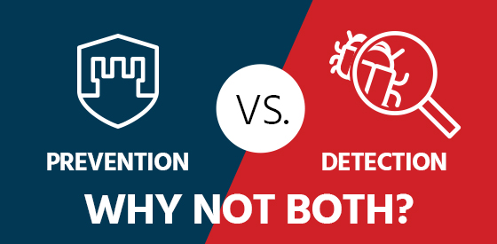
Prevention Versus Detection
Detection :
- Identify
- Correct
Prevention
Train
Do it right from the first time
Quality Comes from Prevention

Slide 18
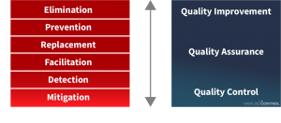
Several disasters because of inadequate software quality !!

Slide 19
Software Quality assurance (SQA)
Chapter 1- Lec2
Introduction and Definitions

Slide 20
What is software quality?
Distinguish between software and other industrial products.
Distinguish the Environment where SQA is applied
Software Quality Assurance vs. Software Quality Control
Classification of the causes of software errors
Software quality – definition
Software quality assurance – definition and objectives
Software quality assurance and software engineering

Slide 21
Factors affecting defect detection in software products vs. other industrial products
Characteristic | Software products | Other industrial products
Complexity | Usually, very complex product allowing for very large number of operational options | Degree of complexity much, lower, allowing at most a few operational options
Visibility of product | Invisible product, impossible to detect defect or omissions by sight(e.g. of a diskette or CD storing the software) | Visible product, allowing effective detection of defects by sight
Nature of development and production process | Opportunities to detect defects arise in only one phase, namely product development | Opportunities to detect defects arise in all phases of development and production: Product development Product production planning Manufacturing

Slide 22
The environment for which SQA methods are developed

Slide 23
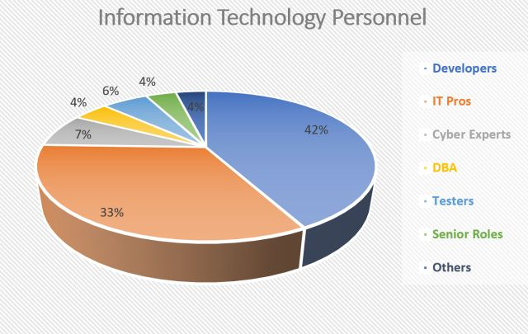
Software developed by many individuals and in different situations fulfills a variety of needs:
Students develop software as part of their education.
Software amateurs develop software as a hobby.
Professionals in engineering, economics, management and other fields develop software to assist them in their work, to perform calculations, summarize research and so forth.
Software development professionals ( system analysts and programmers) develop software products or firmware as a professional career objective

Slide 24

The main characteristics of the environment of professional software development and maintenance (hereafter “the SQA environment)
Contractual conditions: As a result of the conditions defined in the contract between the software developer and the customer, the activities of software development and maintenance need to cope with:
List of requirements needed to be fulfill
The project budget
The project timetable

Slide 25
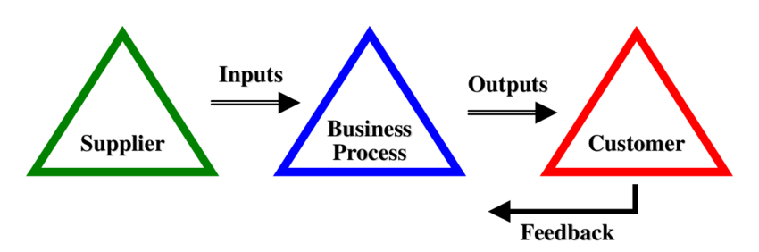
Subjection to customer–supplier relationship: The project team must cooperate continuously with the customer: to consider his request for changes, to discuss his criticisms about the various aspects of the project, and to get his approval for changes initiated by the development team.
3) Required teamwork: Three factors usually motivate the establishment of a
project team rather than assigning the project to one professional:
Timetable requirements. In other words, the workload undertaken during the project period requires the participation of more than one person if the project is to be completed on time.
The need for a variety of specializations in order to carry out the project.
The wish to benefit from professional mutual support and review for the
enhancement of project quality.

Slide 26
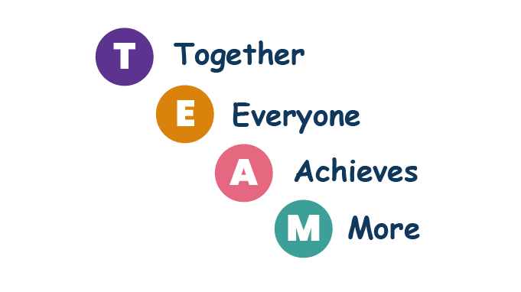
4) Cooperation and coordination with other software teams: Cooperation may be required with:
Other software development teams in the same organization.
Hardware development teams in the same organization.
Software and hardware development teams of other suppliers.
Customer software and hardware development teams that
take part in the project’s development.
5) Interfaces with other software systems: Nowadays, most software systems include interfaces with other software packages. These interfaces allow data in electronic form to flow between the software systems.

Slide 27

6) The need to continue carrying out the project while the team members change.
It is quite common for team members to leave the team during the project development period, whether owing to promotions to higher level jobs, a switch in employers, transfers to another city, and so forth. The team leader then has to replace the departing team member either by another employee or by a newly recruited employee. No matter how much effort is
invested in training the new team member, “the show must go on”, which means that the original project contract timetable will not change.

Slide 28
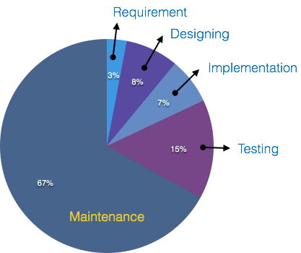
7) The need to continue carrying out software maintenance for an extended period
Customers who develop or purchase a software system expect to continue utilizing it for a long period, usually for 5–10 years. During the service period, the need for maintenance will eventually arise. In most cases, the developer is required to supply these services directly. Internal
“customers”, in cases where the software has been developed in-house, share the same expectation regarding the software maintenance during the service period of the software system.
The environmental characteristics create a need for intensive and continuous managerial efforts parallel to the professional efforts that have to be invested in order to assure the project’s quality, in other words to assure the project’s success.

Slide 29
Software Quality Assurance vs. Software Quality Control
Criteria | Software Quality Assurance (SQA) | Software Quality Control (SQC)
Definition | SQA is a set of activities for ensuring quality in software engineering processes (that ultimately result in quality in software products). The activities establish and evaluate the processes that produce products. | SQC is a set of activities for ensuring quality in software products. The activities focus on identifying defects in the actual products produced.
Focus | Process focused | Product focused
Orientation | Prevention oriented | Detection oriented
Breadth | Organization wide | Product/project specific
Scope | Relates to all products that will ever be created by a process | Relates to specific product
Activities | Process Definition and Implementation Audits Training | Reviews Testing

Slide 30

Patriot Missile System
On February 25, 1991, the Patriot missile battery at Dharan, Saudi Arabia had been in operation for 100 hours, by which time the system's internal clock had drifted by one third of a second. For a target moving as fast as an inbound TBM, this was equivalent to a position error of 600 meters.
The radar system had successfully detected the Scud and predicted where to look for it next, but because of the time error, looked in the wrong part of the sky and found no missile. With no missile, the initial detection was assumed to be a spurious track and the missile was removed from the system. No interception was attempted, and the missile impacted on a barracks killing 28 soldiers.

Slide 31

Denver International Airport
The opening of the new Denver International Airport (DIA) in February 1995 was a day of celebration for Colorado citizens but it was certainly the end of a traumatic period for the information technology industry. DIA was planned to be the largest airport in the United States, to serve 110 000 000 passengers annually by 2020, to handle 1750 flights daily through 200 gates and 12 operating runways. Operations at DIA were delayed by 16 months, mainly due to the failure of the software-based baggage handling system, causing estimated total losses of $2 billion. Moreover, the baggage handling system finally the failure of IT technology at DIA was especially traumatic to the profession, whether due to the scale of the losses or the public interest and criticism it raised. Many SQA professionals, including the author, believe that had appropriate software quality assurance systems been applied to the project at its start, a failure of this scale would not have occurred or, at least, its losses would have been dramatically reduced.

Slide 32
Software Quality assurance (SQA)
Software Quality Factors

Slide 33
“Our new sales information system seems okay, the invoices are correct, the inventory records are correct, the discounts granted to our clients exactly follow our very complicated discount policy, BUT our new sales information system frequently fails, usually at least twice a day, each time for twenty minutes or more. Yesterday it took an hour and half before we could get back to work . . . . Imagine how embarrassing it is to store managers . . . . Softbest, the software house that developed our computerized sales system, claims no responsibility . . . .”

Slide 34
“Believe it or not, our software package ‘Blackboard’ for school teachers, launched just three months ago, is already installed in 187 schools. The development team just returned from a week in Hawaii, their vacation bonus. But we have been suddenly receiving daily complaints from the ‘Blackboard’ maintenance team. They claim that the lack of failure detection features in the software, in addition to the poor programmer’s manual, have caused them to invest more than the time estimated to deal with bugs or adding minor software changes that were agreed as part of purchasing contracts with clients.”

Slide 35
“The new version of our loan contract software is really accurate. We have already processed 1200 customer requests, and checked each of the output contracts. There were no errors. But we did face a severe unexpected problem – training a new staff member to use this software takes about two weeks. This is a real problem in customer departments suffering from high employee turnover . . . . The project team says that as they were not required to deal with training issues in time, an additional two to three months of work will be required to solve the problem.”

Slide 36
The need for comprehensive software quality requirements
Our Sales IS seems v. good , but it is frequently fails, at least twice a day for 20 minutes or more.( SW house claims no responsibility….
Local product contains a SW and every thing is ok, but, when we began planning the development of a European version, almost all the design and programming will be new.

Slide 37
The need for comprehensive software quality requirements
There are some characteristic common to all these “but’s”:
■ All the software projects satisfactorily fulfilled the basic requirements for correct calculations (correct inventory figures, correct average class’s score, correct loan interest, etc.).
■ All the software projects suffered from poor performance in important areas such as maintenance, reliability, software reuse, or training.
■ The cause for the poor performance of the developed software projects in these areas was the lack of predefined requirements to cover these important aspects of the software’s functionality.
The requirements document is one of the most important elements for achieving software quality

Slide 38
The need for comprehensive software quality requirements
There is a need for a comprehensive definition of requirements that will cover all attributes of software and aspects of the use of software, including usability aspects, reusability aspects, maintainability aspects, and so forth in order to assure the full satisfaction of the users.

Slide 39
Quality factors
The great variety of issues related to the various attributes of software and its use and maintenance, as defined in software requirements documents, can be classified into groups called quality factors.
The team responsible for defining the software requirements of a software system is expected to examine the need to define the requirements that belong to each factor

Slide 40
Classification of software requirements into software quality factors.
McCall’s factor model classifies all software requirements into 11 software quality factors. The 11 factors are grouped into three categories as follows:
1- Products operation factors: (daily operation of the software)
Correctness, Reliability, Efficiency, Integrity, Usability.
2- Product revision factors: (maintenance activates)
Maintainability, Flexibility, Testability.
3- Product transition factors: (software adaptation to other environments and it’s interaction with other software systems)
Portability, Reusability, Interoperability.

Slide 41
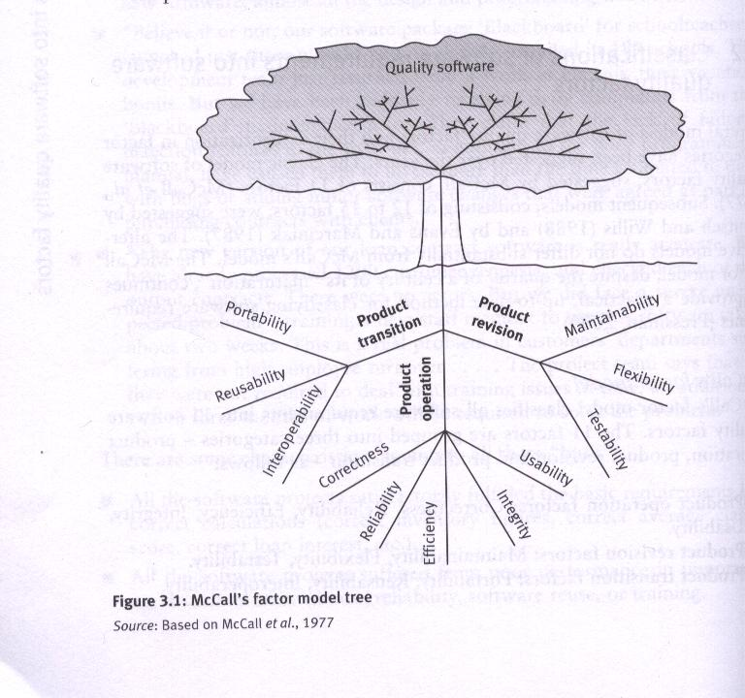

Slide 42
Product operation software quality factors
Deals with requirements that directly affect the daily operation of the software.
Correctness:
Correctness requirements are defined in a list of the software system’s required outputs
How many errors there are in the software?

Slide 43
Correctness
Output specifications are usually multidimensional; some common dimensions include:
The output mission (e.g., sales invoice printout, and red alarms when temperature rises above 250°F).
The required accuracy of those outputs that can be adversely affected by inaccurate data or inaccurate calculations.
The completeness of the output information, which can be adversely affected by incomplete data.
The up-to-dateness of the information (defined as the time between the event and its consideration by the software system).
The availability of the information (the reaction time, defined as the time needed to obtain the requested information or as the requested reaction time).

Slide 44
Correctness Example (club membership info system)
1. Output mission: list of 11reports, 4 standard letters, 3 interactive queries.
2. Required accuracy: prob of a non-accurate output <1%.
3. Completeness: prob of missing data about a member, attendance, payments etc < 1%.
4. Up-to-dateness: no more than 2 days for info about event participation to be valid
5. Availability: reaction time to queries < 2 seconds, to reports < 4 hours

Slide 45
Product operation software quality factors
Reliability: Reliability requirements deal with failures to provide services. They determine the maximum allowed SW system failure rate, and can refer to entire system or one of its function.
E.g. The failure frequency of a heart-monitoring unit that will operate in a hospital’s intensive care ward is required to be less than one in 20 years. Its heart attack detection function is required to have a failure rate of less than one per million cases.

Slide 46
Product operation software quality factors
Efficiency: Efficiency requirements deal with the hardware resources needed to perform all the functions of the software system in conformance to all other requirements.
Ex.
Processing power (MIPS, MHz)
Storage capacity (GBytes, TBytes)
Data communication capabilities (MBPS, GBPS)

Slide 47
Product operation software quality factors
Integrity: Integrity requirements deal with the software system security. That is requirements to prevent unauthorized access.
Ex. “read only” permit

Slide 48
Product operation software quality factors
Usability: Usability requirements deal with the scope of staff needed to train a new employee and to operate the software system.
Eg Help Desk requirements
Two days to train new staff
One staff to handle 60 calls per day

Slide 49
Product revision software quality factors:
Deal with those requirements that affect the complete range of software maintenance activities:
Corrective maintenance: correction of software faults and failures. Adaptive maintenance: adapting the current software to additional circumstances and customers without changing the software. Perfective maintenance: enhancement and improvement of existing software with respect to locally limited issues.

Slide 50
Product revision software quality factors:
The three quality factors comprise the product revision category are: Maintainability: Maintainability requirements determine the efforts that will be needed by users and maintenance personnel to identify the reasons for software failures, to correct the failures, and to verify the success of the corrections.

Slide 51
Product revision software quality factors:
This factor’s requirements refer to 1- The modular structure of software 2- The internal program documentation 3- The programmer’s manual.
Examples: a- The size of a software module will not exceed 30 statements b- The programmer will adhere to the company coding standards and guidelines.

Slide 52
Product revision software quality factors:
Flexibility: The capabilities and efforts required to support adaptive maintenance activities are covered by the flexibility requirements.
These include the resources (in man-days) required to adopt a software to a varieties of customers of the same trade and of various extents of activities.

Slide 53
Product revision software quality factors:
The flexibility requirements also support perfective maintenance activities, such as changes and additions to the software in order to improve its service and to adapt it to changes in the technical or commercial environment.

Slide 54
Product revision software quality factors:
As example TSS (teacher support SW.) calculation of final grades, pupil achievements…etc
The SW specifications of TSS include the following flexibility requirements:
a) The SW should be suitable for all teachers of all subjects and all school levels
b) Non-professionals should be able to create new types of reports according to schoolteacher’s requirements.

Slide 55
Product revision software quality factors:
Testability: Testability requirements deal with the testing of an information system as well as with its operation.
Testability requirements for the ease of testing are related to special features in the programs that help the tester, for instance by providing predefined immediate results and log files.
Testability requirements related to software operation include automatic diagnostics performed by the software system prior to starting the system, to find out whether all components of the software system are in working order and to obtain a report about the detected faults.

Slide 56
Product revision software quality factors:
Example
An industrial computerized control unit is programmed to calculate various measures of production status, report the performance level of the machinery, and operate a warning signal in predefined situations.
One testability requirement demanded was to develop a set of standard test data with known system expected correct reactions in each stage. This standard test data is to be run every morning, before production begins, to check whether the computerized unit reacts properly.

Slide 57
Product Transition software quality factors:
Factors that deals with the adaptation of software to other environments and it’s interaction with other software systems Portability: Portability requirements tend to the adaptation of a software system to other environments consisting of different hardware, different operating systems, and so forth. It make possible to use the software in different SW and HW simultaneously. Example :A software package which designed and programmed to operate in a Windows 7 environment is required to allow low-cost transfer to Linux and Windows NT environments.

Slide 58
Product Transition software quality factors:
Reusability: Reusability requirements deal with the use of software modules originally designed for one project in a new software project currently being developed.
The reuse of SW is expected to save development resources, shorten the development period and provide higher quality modules. These benefits based on the assumption that the most of the SW faults have already been detected and solved

Slide 59
Product Transition software quality factors:
Interoperability: Interoperability requirements focus on creating interfaces with other software systems or with other equipment firmware. Interoperability requirements can specify the names of the software or firmware for which interface is required. The can also specify the output structure accepted as standard in a specific industry or applications area.
Example: The firmware of a medical laboratory’s equipment is required to process its results (output) according to a standard data structure that can then serve as input for a number of standard laboratory information systems.

Slide 60
Software Quality assurance (SQA)
Software Quality Factors
Dr Khalid Alnafjan
kalnafjan@ksu.edu.sa

Slide 61
Software quality factors
The need for comprehensive software quality requirements
Classification of requirements into software quality factors
Product operation factors
Product revision factors
Product transition factors
Alternative models of software quality factors
Who is interested in defining quality requirements?
Software compliance with quality factors

Slide 62
We need what is called software quality factors that is included in requirements document

Slide 63
There are different software quality factors and models.
The classic software quality factory model is
McCall software quality factor

Slide 64
McCall's software quality
factors model
Software quality factors
Product operation factors
Product revision factors
Product transition factors

Slide 65
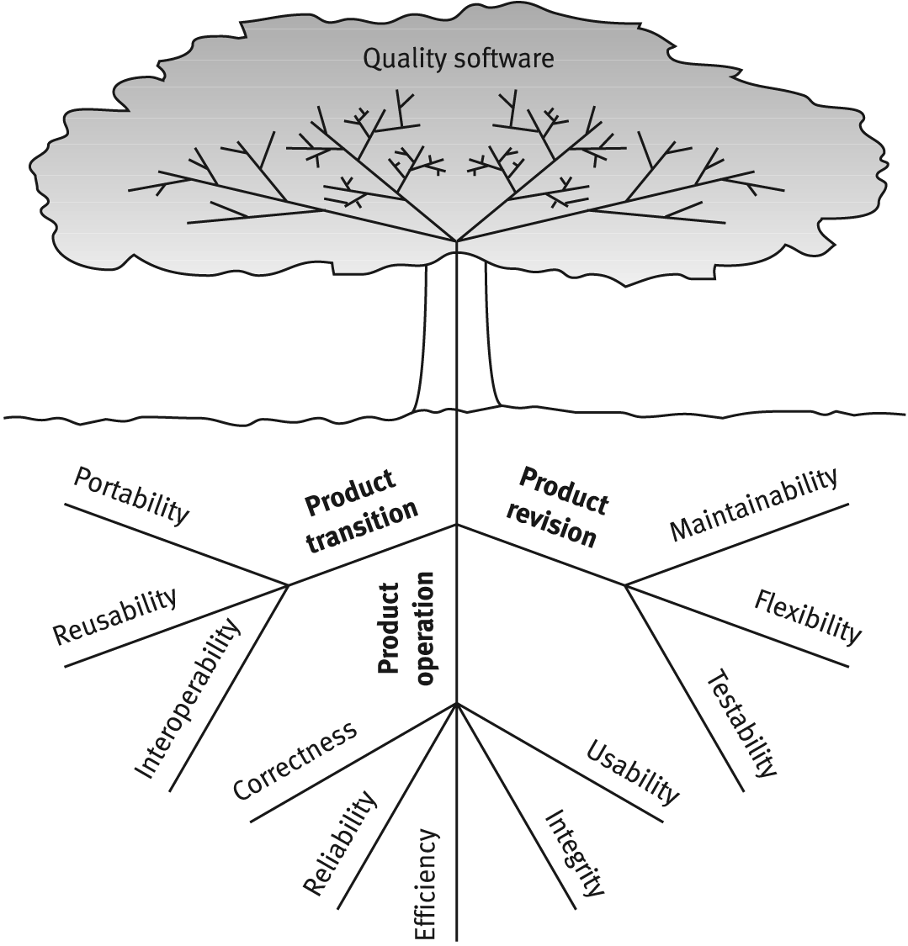
McCalls factor model tree

Slide 66
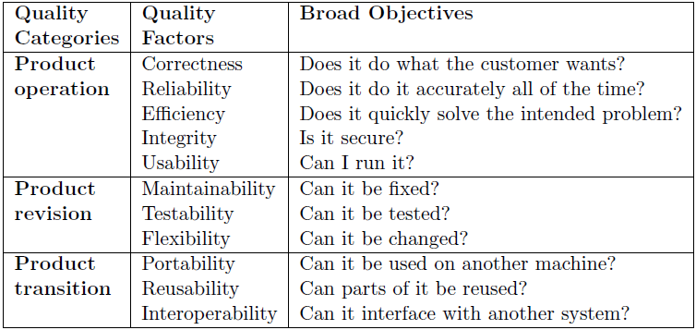
Software quality factors

Slide 67
How Does McCall factors improve quality
McCall quality factors could be used as a reference when preparing requirements document. Most, if not all, of those factors should be covered explicitly in the software requirements document.
Measuring those factors tell us where we need improvement. We can use quality metrics

Slide 68
Alternative models of software quality factors:
Two factor models, appearing during late 1988s, considered to be alternatives to Mccall classic factor model: 1-The Evans and Marciniak factor model 1987. 2-The Deutsh and Willis factor model 1988. A formal comparison of the factor models reveals:
■ Both alternative models exclude only one of McCall’s 11 factors, namely the testability factor.
■ The Evans and Marciniak factor model consists of 12 factors that are classified into three categories.
■ The Deutsch and Willis factor model consists of 15 factors that are classified into four categories

Slide 69
Alternative models of software quality factors:
Five new factors were suggested by the two alternative factor models: 1-Verifiability.(by both) 2- Expandability. (by both) 3- Safety. (by Deutsh and willis) 4- Manageability. (by Deutsh and willis) 5- Survivability. (by Deutsh and willis)

Slide 70
Alternative models of software quality factors:
Verifiability: Verifiability requirements define design and programming features that enable efficient verification of the design and programming. Most verifiability requirements refer to modularity, to simplicity, and to adherence to documentation and programming guideline.

Slide 71
Alternative models of software quality factors:
Expandability: Expandability requirements refer to future efforts that will be needed to serve large populations, improve service, or add new applications in order to improve usability.
The majority of these requirements are covered by McCall`s flexibility factor.

Slide 72
Alternative models of software quality factors:
Safety: Safety requirements are meant to eliminate conditions dangerous to operators of equipment as a result of errors in process control software. These errors can result in inappropriate reactions to dangerous situations or to the failure to provide alarm signals when the dangerous conditions to be detected by the software arise.

Slide 73
Alternative models of software quality factors:
Safety Example
In a chemical plant, a computerized system controls the flow of acid according to pressure and temperature changes occurring during production.
The safety requirements refer to the system’s computerized reactions in cases of dangerous situations and also specify what kinds of alarms are needed in each case.

Slide 74
Alternative models of software quality factors:
Manageability: Manageability requirements refer to the administrative tools that support software modification during the software development and maintenance periods, such as configuration management, software change procedures.
Example : “Chemilog” is a software system that automatically logs the flows of chemicals into various containers to allow for later analysis of the efficiency of production units. The development and issue of new versions and releases of “Chemilog” are controlled by the Software Development Board, whose members act according to the company’s software modifications procedure.

Slide 75
Alternative models of software quality factors:
Survivability
Survivability requirements refer to the continuity of service. Defined as: - the minimum time allowed between failures of the system - the maximum time permitted for recovery of service,
two factors that pertain to service continuity.

Slide 76
Alternative models of software quality factors:
By comparing the contents of the factor models we fined that: - Expandability and Survivability actually resemble Flexibility and Reliability. - Testability can be considered as one element in Maintainability factor. Therefore the alternative factor models add only three new factors to McCall`s model : Verifiability, Safety, and Manageability.

Slide 77
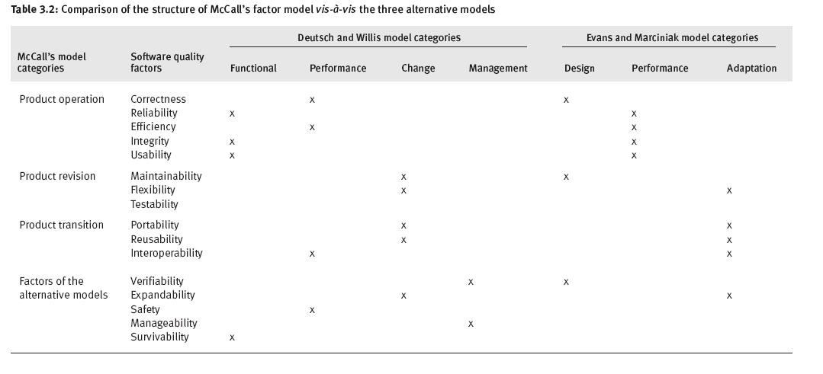
Structure of the alternative factor models

Slide 78
Who is interested in the definition of quality requirements?
1- The client: The requirements document he prepares does indeed serve as a fundamental protection against low quality
2- The software developer: add requirements represent his own interest.

Slide 79
Who is interested in the definition of quality requirements?
Examples: (1) Reusability requirements. In cases where the client anticipates development in near future of an additional software system having strong similarities to the present software, the client will himself initiate reusability requirements .In other cases, the client is interested in reusing parts of software systems that were developed earlier in a new system.

Slide 80
Who is interested in the definition of quality requirements?
The developer, who serves a great variety of clients, will recognize the potential benefits of reuse, and will enter reusability into the list of requirements to be fulfilled by the project team.

Slide 81
Who is interested in the definition of quality requirements?
(2) Verifiability requirements. These requirements are meant to improve the design reviews and software tests carried out during software development. Their aim is to save development resources and they are, therefore, of interest to developers. The client, however, is usually uninterested in placing requirements that deal with the internal activities of the developer team.

Slide 82
Who is interested in the definition of quality requirements?
The following list of quality factors usually interest the developer whereas they may raise very little interest on the part of the client: 1- Portability 2- Reusability 3- Verifiability.

Slide 83
Who is interested in the definition of quality requirements?
So, The project might be carried out according to two requirements documents:
1- the client's requirements document 2- The developer's additional requirements document.

Slide 84
Software compliance with quality factors
Throughout the software development process, the extent to which the process complies with the requirements of the various quality factors is examined by design reviews, software inspections, software tests, and so forth.

Slide 85
Example
The software requirement document for the tender for development of “Super-lab,” a software system for managing a hospital laboratory, consists of chapters according to the required quality factors as follows: correctness, reliability, efficiency, integrity, usability, maintainability, flexibility, testability, portability, reusability and interoperability

Slide 86
McCall's factor model
and alternative models

Slide 87
Criteria for evaluation of software quality
Examples:
Flight software that flies on a single mission satellite will not be concerned with portability but may be very concerned with reliability.
A software system that remains on the ground may be concerned with portability and not very concerned by reliability.

Slide 88
Software quality factors in requirements document
Correctness
Employees salaries should not be late (Wrong)
Employees salaries should be calculated accurately and must be ready five days before the end of the month (Correct)
Reliability
The system should be working as much time as possible (Wrong)
The system should not be in failure status during working hours (9 to 4). Total time of failure status should not exceed 20 minutes per month. (Correct)

Slide 89
Software quality factors in requirements document
Efficiency
The GPS application should use as little as possible of mobile phone battery (Wrong)
The GPS application should not use more than 10% of battery power in two hours time (Correct)
Integrity
Students should be allowed to access their final marks(Wrong)
Students should be allowed to view their final marks. They should not be able to make any changes (Correct)

Slide 90
Software quality factors in requirements document
Usability
The billing system should be easy to use (Wrong)
Billing staff should be able to learn the most important five functions of the billing system in 3 working hours.

Slide 91
See Chapter 3 Summary and try to answer some questions

Slide 92
Chapter 4
The Components of The Software Quality Assurance System- Overview

Slide 93
Introduction
This chapter is dedicated to an overview of the wide range of SQA components.
it will allow you to obtain some preliminary understanding about the important role of each component, and about the entire range of components,

Slide 94
Components of software quality
assurance system overview
Pre-project components
Software project life cycle components
Infrastructure components for error prevention and improvements
Management SQA components
SQA standards, system certification and assessment components
Organizing for SQA – the human components

Slide 95
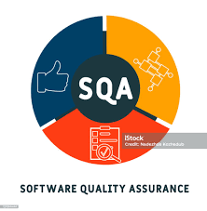
The SQA system – an SQA architecture
An SQA system always combines a wide range of SQA components, all of which are employed to challenge the multitude of sources of software errors and to achieve an acceptable level of software quality
The environment in which software development and maintenance is undertaken directly influences the SQA components

Slide 96
The SQA system- a SQA architecture
SQA system components can be classified into six classes: 1- Pre-Project Components.: To assure that
the project commitments have been adequately defined considering the resources required, the schedule and budget.
the development and quality plans have been correctly determined

Slide 97
SQA system components
2. Components of project life cycle activities assessment. The project life cycle is composed of two stages:
the development life cycle stage and the operation–maintenance stage.
The development life cycle stage components detect design and programming errors.
Its components are divided into the four sub-classes:
– Reviews
– Expert opinions
– Software testing
– Assurance of the quality of the subcontractors` work.
The SQA components used during the operation–maintenance phase include specialized maintenance components as well as development life cycle components, which are applied mainly for functionality improving maintenance tasks

Slide 98
SQA system components
3. Components of infrastructure error prevention and improvement : which are applied throughout the entire organization, to eliminate or at least reduce the rate of errors.
4. Components of software quality management the objective of this components is to define managerial support actions that mainly prevent or minimize schedule and budget failures and their outcomes.

Slide 99
SQA system components
5. Components of standardization, certification, and SQA system assessment:
These components implement international professional and managerial standards within the organization.
The main objectives of this class are :
Utilization of international professional knowledge,
Improvement of coordination of the organizational quality systems with other organizations.
Assessment of the achievements of quality systems according to a common scale.

Slide 100
SQA system components
6- Organizing for SQA – the human components.
The SQA organizational base includes managers, testing personnel, the SQA unit and practitioners interested in software quality (SQA trustees, SQA committee members and SQA forum members). All these actors contribute to software quality;
Their main objectives are:
To develop and support implementation of SQA components.
To detect deviations from SQA procedures and methodology.
To suggest improvements to SQA components.

Slide 101
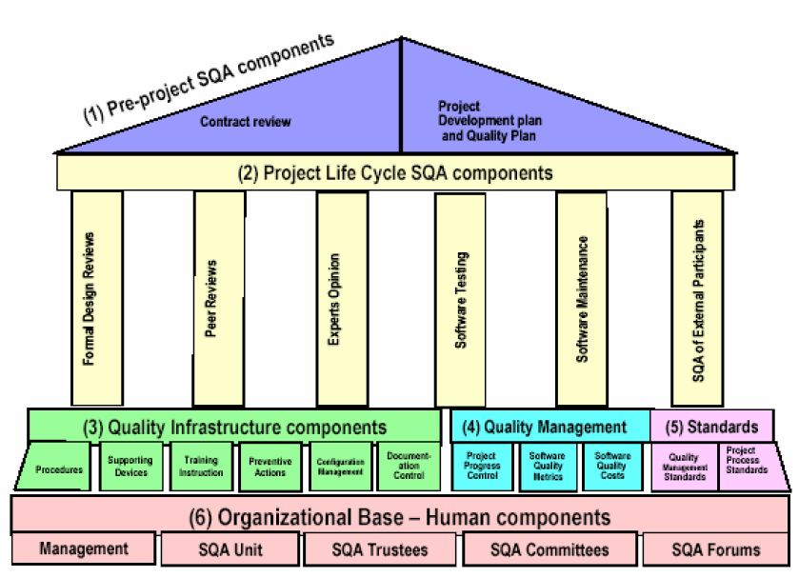
The SQA System Overview

Slide 102
1. Pre-Project Components
The SQA components here are meant to improve the preparatory steps taken prior to initiating work on the project itself:
It includes two components :
Contract review
Development and quality plans

Slide 103
Contract review
Software may be developed in response to: 1- A contract negotiated with a customer 2- An internal order originating in another department (like a request for developing a firmware software system to be embedded within a hardware product)
The development unit is committed to an agreed-upon functional specification, budget and schedule.
Accordingly, The contract review activity is conducted in two stages :
Stage One – Review of the proposal draft
prior to submission to the potential customer
(“proposal draft review”).
Stage Two – Review of contract draft
prior to signing (“contract draft review”)..

Slide 104
Contract review
Specifically ,contract review activities include:
1) Clarification of customer's requirements
2) Review of the project's schedule and resource requirement estimates
3) Evaluation of the professional staff's capacity to carry out the proposed project
4) Evaluation of the customer's capacity to fulfill his obligations
5) Evaluation of development risks
the review of maintenance contracts: take into account that besides error corrections, maintenance services include software adaptation and limited software development activities for the sake of performance improvement

Slide 105
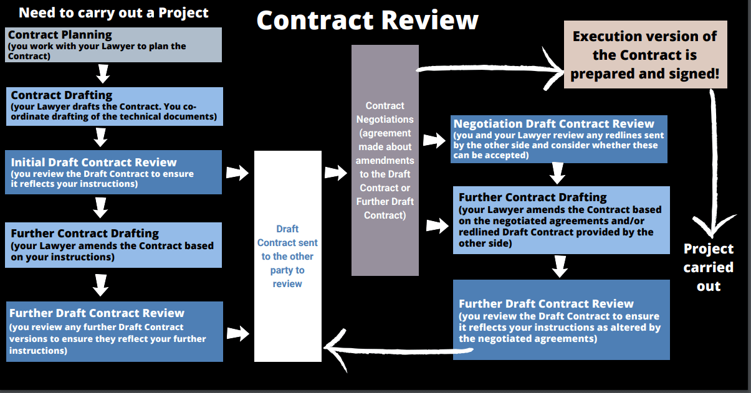
Who performs a contract review ?
The leader and members of the proposal team
An outside professional or a company staff member who is not a member of the proposal team
A team of outside experts.

Slide 106
Development and quality plans
Once a software development contract has been signed or a commitment made to undertake an internal project , a plan is prepared of the project (“development plan”) and its integrated quality assurance activities (“quality plan”).
These plans include additional details and needed revisions based on prior plans that provided the basis for the current proposal and contract.
The plans must be revised, changes might occur.
The main issues treated in project development plan are:
Schedules
Required manpower and hardware resources
Risk evaluations
Organizational issues: team members, subcontractors and partnerships
Project methodology, development tools, etc.
Software reuse plans.

Slide 107
Development and quality plans
The main issues treated in the project's quality plan are:
Quality goals,
Refer to developed software system quality requirement
Expressed in the appropriate measurable terms
Examples:- A software system to serve the help desk operations of an electrical appliance manufacture is to be developed. The help desk system (HDS) is intended to operate for 100 hours per week.
Criteria for starting and ending each project stage
Lists of reviews, tests, and other scheduled verification and validation activities.

Slide 108
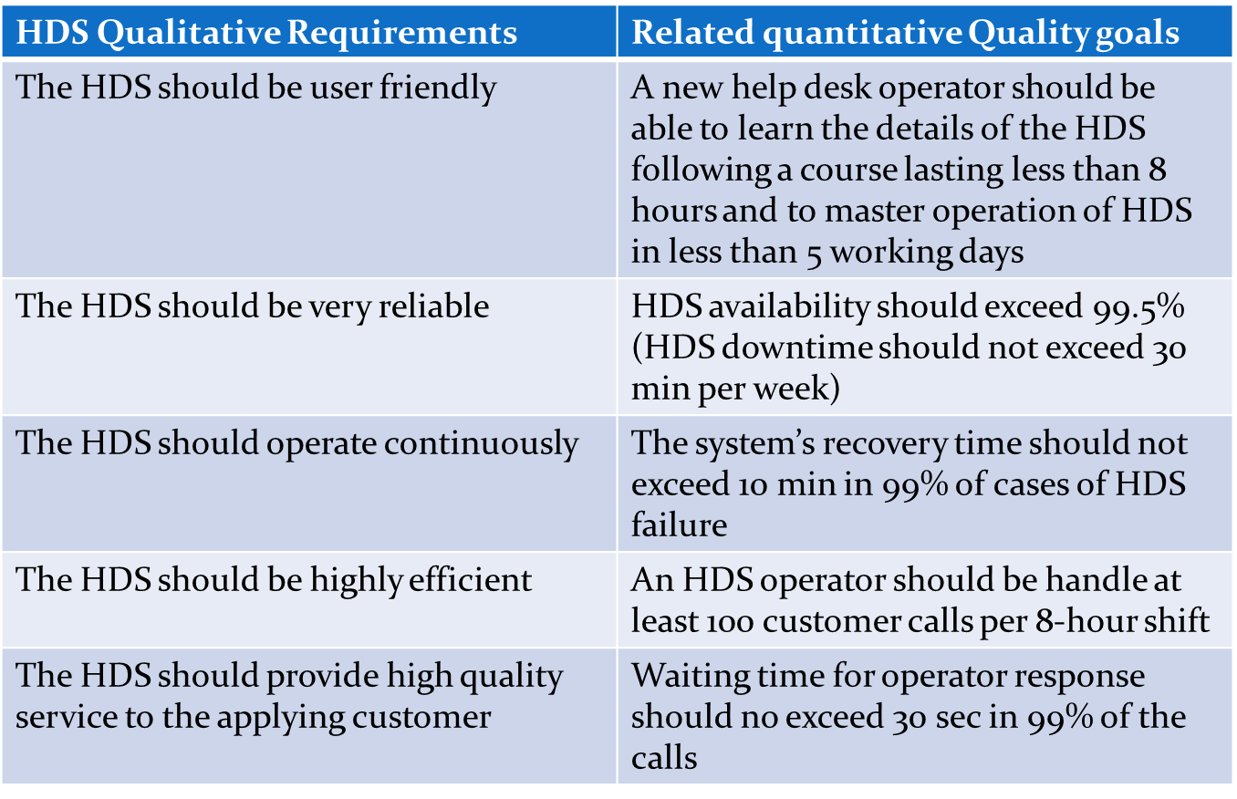
Quality requirements

Slide 109
2. Software project life cycle components
The project life cycle is composed of two stages:
The development life cycle stage
The operation –maintenance stage

Slide 110
Software project life cycle components
The main components are:
Reviews
Expert opinions
Software testing
Software maintenance
Assurance of the quality of the subcontractors` work and customer supplied parts.
As we can see that several SQA components enter the SW development project life cycle at different points. So their use should be planned prior to the project’s initiation

Slide 111
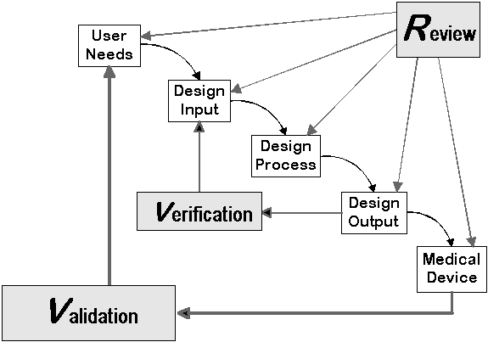
Reviews
Reviews can be categorized as:
Formal design reviews (DRs)
Peer reviews

Slide 112
Formal design reviews (DRs)
The design phase of the development process produces a variety of documents include: design reports, software test documents, software installation plans and software manuals, among others.
A significant portion of the design documents requires formal professional approval of their quality as related to the contract and the procedures applied by the developer.
It should be emphasized that the developer can continue to the next phase of the development process only on receipt of formal approval of these documents

Slide 113
Formal design reviews (DRs)
Formal design reviews (DRs) are carried out by Ad hoc committees whose members may include:
The review leader
Knowledge and experience in development of projects.
Seniority at a level similar to if not higher than that of the project leader.
A good relationship with the project leader and his team.

Slide 114
Formal design reviews (DRs)
The review team
Senior members of the project team
Appropriate senior professionals assigned to other projects and departments
Customer–user representatives,
Software development consultants.
A review team of three to five members is expected to be an efficient team, as an excessively large team tends to create coordination problems and , waste review session time

Slide 115
Formal design reviews (DRs)
One of the review leader’s responsibilities is to issue the DR report immediately after the review session
The DR report includes a list of required corrections ( called Action items ). Options open for consideration by the DR committee:
1- Immediate approval of the DR document and continuation to the next development phase

Slide 116
Formal design reviews (DRs)
2- Approval to proceed to the next development phase after all the action items have been completed and inspected by the committee` s representative
3- An additional DR is required and scheduled to take place after all action items have been completed and inspected by the committee` s representative.

Slide 117
Peer review
Peer reviews ( inspection and walkthroughs ) are directed at reviewing short documents, chapters or parts of a report, a coded printout of a software module.
The process can take several forms and use many methods; Usually the reviewers are all peers, not superiors.
The main objective of the process is to detect as many design and programming faults as possible. The output is a list of detected faults.
A defect summary and statistics to be used as a database for reviewing and improving development methods

Slide 118
Expert opinions
Expert opinions support quality assessment efforts by introducing additional external capabilities into the organization’s in-house development process.
External experts may be useful in the following situations:
1- Insufficient in-house professional capabilities in a given area.
2- Temporary inaccessibility of in-house professionals (waiting will cause substantial delays in the project completion schedule).
.

Slide 119
Expert opinions
3- In small organizations ,it is difficult to find enough suitable candidates to participate in the design review teams. In such situations, outside experts may join a DR committee or, alternatively, their expert opinions may replace a DR.
4- In small organizations or in situations characterized by extreme work pressures, an outside expert’s opinion can replace an inspection.
5- In cases of major disagreement among the organization's senior professionals, an outside expert may support a decision.

Slide 120
Chapter 4
The Components of The Software Quality Assurance System- Overview

Slide 121
The SQA System Overview

Slide 122
Peer review
Peer reviews ( inspection and walkthroughs ) are directed at reviewing short documents, chapters or parts of a report, a coded printout of a software module.
The process can take several forms and use many methods; Usually the reviewers are all peers, not superiors.
The main objective of the process is to detect as many design and programming faults as possible. The output is a list of detected faults.
A defect summary and statistics to be used as a database for reviewing and improving development methods

Slide 123
Expert opinions
Expert opinions support quality assessment efforts by introducing additional external capabilities into the organization’s in-house development process.
External experts may be useful in the following situations:
1- Insufficient in-house professional capabilities in a given area.
2- Temporary inaccessibility of in-house professionals (waiting will cause substantial delays in the project completion schedule).
.

Slide 124
Expert opinions
3- In small organizations ,it is difficult to find enough suitable candidates to participate in the design review teams. In such situations, outside experts may join a DR committee or, alternatively, their expert opinions may replace a DR.
4- In small organizations or in situations characterized by extreme work pressures, an outside expert’s opinion can replace an inspection.
5- In cases of major disagreement among the organization's senior professionals, an outside expert may support a decision.

Slide 125
Software testing
Software tests are formal SQA components that are used to review the actual running of the software.
The tests are based on a prepared list of test cases that represent a variety of expected scenarios.
Tests examine modules, integration, or entire packages (systems)
Recurrent tests( regression tests), carried out after correction of previous test findings, are continued till satisfactory results are obtained.

Slide 126
Software testing
Direct objectives of the software tests:
1- Detection of software faults and other failures to fill the requirements.
2- The formal approval of a module or integration setup so that either the next programming phase can start or the completed software system can be delivered and installed.

Slide 127
Software testing
Software testing programs are constructed from a variety of tests, some manual and some automated.
All tests have to be designed, planned, and approved according to development procedures.
The test report will include a detailed list of the faults detected
It is recommended that software tests be carried out by an independent, outside testing unit rather than by the project team
Project team SHOULD NOT involved in S/W testing because they failed to detect defects during development as well as to avoid conflicts of interest.

Slide 128
Software maintenance components
Software maintenance services vary in range and are provided for extensive periods, often several years.
The services fall into the following categories
1- Corrective maintenance
User support services (address for solution of all user difficulties arising when using the software system)
software corrections
The user’s difficulties may have been caused by:
Code failure (usually termed “software failure”).
Documentation failure in the user’s manual
Incomplete, vague or imprecise documentation.
User’s insufficient knowledge of the software system

Slide 129
Software maintenance components
2- Adaptive maintenance
Adjusts the software package to the requirements of new customers and changing environmental conditions
3- Functionality improvement maintenance
Addition of new functions to the existing software, improvement of reliability, etc

Slide 130
Software maintenance components
Software maintenance services should meet all kinds of quality requirements,
Functionality requirements
Scheduling requirements (generally decided together with the customer)
Budget limitations (determined by the service provider).
The main SQA components employed in the quality assurance of the maintenance system are as follows:
1- Pre-maintenance components
Maintenance contract review
Maintenance plan.

Slide 131
Software maintenance components
2- Software development life cycle components
These components are applied for functionality improvement and adaptive maintenance tasks which is similar to the activities of S/W development.
3- Infrastructure tools that support maintenance quality assurance
4- Managerial tools for controlling software maintenance quality

Slide 132
Assurance of the quality of the external participant`s work
Subcontractors and customers frequently join the directly contracted developers ( the supplier ) in carrying out software development projects.
The larger and more complex project the greater the likelihood that external participant will be required. The larger the proportion of work transmitted to them (subcontractors, suppliers of COTS software and the customer)
Most of the SQA controls applied to external participants are defined in the contracts singed between the relevant parties.

Slide 133
3. Infrastructure components for error prevention and improvement:
The goal of these components is to prevent software faults or at least lower the faults rate along with improving productivity.
These components are devised to serve a wide range of projects and software maintenance services
It includes the following components:
Procedures and work instructions
Staff training, retraining, and certification
Preventive and corrective actions
Configuration management
Documentation control
Supporting quality devices

Slide 134
1- Procedures and work instructions
QA procedures provide detailed definitions for the performance of specific types of development activities in a way that assures effective achievement of quality results.
Work instructions provide detailed directions for the use of methods that are applied in unique instances and employed by specialized teams.
Procedures and work instructions are based on the organization’s accumulated experience and knowledge.

Slide 135
2-Supporting quality devices
One way to combine higher quality with higher efficiency is to use supporting quality devices, such as templates and checklists. Which is based on the accumulated knowledge and experience of the organization’s development and maintenance professionals, contribute to meeting SQA goals by:
1- Saving the time required to define the structure of the various documents or prepare lists of subjects to be reviewed.
2- Contributing to the completeness of the documents and reviews.
3- Improving communication between development team and review committee members by standardizing documents and agendas.

Slide 136
3-Staff training, retraining, and certification
The trained and well-instructed professional staff is the key to efficient , quality performance.
Keeping an organization’s human resources knowledgeable and updated at the level required is achieved mainly by:
Training new employees and retraining those employees who have changed assignments.
Continuously updating staff with respect to professional developments and the in-house, hands-on experience required.
Certifying employees after their knowledge and ability have been demonstrated.

Slide 137
4-Preventive and corrective actions
Systematic study of the data collected regarding instances of failure and success contributes to QA process in many ways such as:
Implementation of changes that prevent similar failures in the future.
Correction of similar faults found in other projects and among the activities performed by other teams.
Implementing proven successful methodologies to enhance the probability of repeat success.
The sources of these data : DR reports, SW test report and Customer complaints.

Slide 138
5-Configuration management
The regular software development and maintenance operations involve intensive activities that modify software to create new versions and releases.
These activities are conducted throughout the entire software service period (usually lasting several years) in order to cope with the needed corrections, adaptations to specific customer requirements, application improvements, and so forth
Different team members carry out these activities simultaneously, although they may take place at different sites.

Slide 139
Configuration management
As a result, serious dangers arise, whether of misidentification of the versions or releases, loss of the records delineating the changes implemented, or loss of documentation. Consequently failures may be caused
Configuration management deals with these hazards by introducing procedures to control the change process:
1- approval of changes,
2- the recording of those changes performed,
3- the issuing of new software versions and releases,

Slide 140
Configuration management
4-the recording of the version and release specifications of the software installed in each site,
5- the prevention of any changes in approved versions and releases once they are issued.
Most configuration management systems implement computerized tools to accomplish their tasks.
Software configuration procedures generally authorize an administrator or a configuration management committee to manage all the required configuration management operations.

Slide 141
6-Documentation control
SQA requires the application of measures to ensure the efficient long-term availability of major documents related to software development (“controlled documents”).
The purpose of one type of controlled document – the quality record – is mainly to provide evidence of the SQA system’s performance. Documentation control therefore represents one of the building blocks of any SQA system.
Documentation control mainly referred to customer requirement documents, contract documents, design reports, project plans, development standards, etc

Slide 142
6-Documentation control
Documentation control activities entail:
Definition of the types of controlled documents needed
Specification of the formats,
Definition of review and approval processes for each controlled document
Definition of the archive storage methods
Controlled documents contain information important to the long-term development and maintenance of the software system, e.g SW test results, DR reports, problem reports, audit reports.
Quality records mainly contribute to the system’s ability to respond to customer claims in the future.

Slide 143
4. Management SQA components
They support the managerial control of software development project and maintenance services.
It includes the following components:
Project progress control
Software quality metrics
Software quality costs.

Slide 144
Project progress control
The main objective is to detect the appearance of any situation that may includes deviations from the project plans and maintenance service performance.
Clearly, the effectiveness and efficiency of the corrective measures implemented is dependent on the timely discovery of undesirable situations.
Project control activities focus on:
Project schedule control
Project resource control
Project budget control
Control of risk management activities

Slide 145
Software quality metrics
You can’t control what you can’t measure
Measurement of the various aspects of software quality is considered to be an effective tool for the support of control activities and the initiation of process improvements during the development and the maintenance phases.
There are metrics for:
Quality of SW development and maintenance activities
Development team productivities
SW faults density

Slide 146
Software quality costs
The quality costs incurred by software development and application are, according to the quality costs model, the costs of control (prevention costs, appraisal costs) combined with the costs of failure (internal failure costs, external failure costs)
Analysis of software quality costs can direct SQA efforts to the improvement of activities that cause significant failures with their attendant high failure costs or, alternatively, to make expensive control activities more efficient.

Slide 147
5. SQA standards, system certification, and assessment components
External tools offer another avenue for achieving the goals of software quality assurance.
The main objectives of these standards are :
1) Utilization of international professional knowledge
2) Improvement of coordination with other organizations` quality systems
3) Professional evaluation and measurement of the achievements of the organization’s quality systems.
The standards available may be classified into two main sub-classes: quality management standards and project process standards. Either or both of the two sub-classes can be required by the customer.

Slide 148
Quality management standards
These standards focus on what is required and leave the decision about how to achieve it to the organization
Organizations that comply with quality achievement requirements can then seek SQA certification.
The most familiar examples of this type of standard are:
■ SEI CMM assessment standard
■ ISO 9001 and ISO 9000-3 standards.

Slide 149
Project process standards
Project process standards are professional standards that provide methodological guidelines (dealing with the question of “how”) for the development team.
Well-known examples of this type of standards are:
■ IEEE 1012 standard
■ ISO/IEC 12207 standard.

Slide 150
6. Organizing for SQA – the human components (SQA base)
The SQA components require an organizational base (Framework ), This base includes:
The organization's management
Software testing personnel
SQA units
Professionals and other practitioners interested in SQ (SQA trustees, SQA committee members, SQA forums)
All these form the organizational software quality framework or, in our terms, the SQA organizational base.

Slide 151
SQA base Objectives
The main objectives of the SQA organizational base are as follows:
To develop and support implementation of SQA components
To detect deviations from SQA procedures and methodology
To suggest improvements to SQA components
Although the entire SQA organizational base shares these objectives, each segment of the organizational base concentrates on specific tasks.

Slide 152
Management's role in SQA
The responsibilities of top management, departmental management, and project management include the following:
Definition of the quality policy
Effective follow-up of quality policy implementation
Allocation of sufficient resources to implement quality policy
Assignment of adequate staff
Follow-up of compliance of quality assurance procedures
Solutions of schedule, budget and customer relations difficulties.

Slide 153
The SQA unit
This unit and software testers are the only parts of the SQA organizational base that devote themselves full-time to SQA matters; that is, they can be considered as “fulltime SQA staff”
Other SQA organizational base (managerial and professional staff) contribute only some of their time to software quality issues.
Thus, the SQA unit’s task is to serve as the main moving force, initiator, and coordinator of the SQA system and its application.

Slide 154
The SQA unit
This task can be broken down into a number of primary roles:
1- Preparation of annual quality programs
2- Consultation with in-house staff and outside experts on software quality issues
3- Conduct of internal quality assurance audits
4- Leadership of quality assurance various committees
5- Support of existing quality assurance infrastructure components and their updates, and development of new components.

Slide 155
SQA trustees, committees and forums
SQA trustees: are members of development and maintenance teams who have a special interest in SW quality and are prepared to give a part of their time to these issues.
SQA trustees contributions include:
■ Solving team or unit local quality problems
■ Detecting deviations from quality procedures and instructions
■ Initiating improvements in SQA components
■ Reporting to the SQA unit about quality issues in their team or unit.

Slide 156
SQA trustees, committees and forums
SQA committees: are member of various SW development and maintenance units, and are usually appointed for term or ad hoc service
The main issues dealt with by the committees are
1-Solution of software quality problems.
2- Analysis of problem and failure records as well as other records, followed by initiation of corrective and preventive actions when appropriate.
3-Initiation and development of new procedures and instructions; updating existing materials.
4- Initiation and development of new SQA components and improvement of existing components.

Slide 157
SQA trustees, committees and forums
SQA forums : are composed of professionals and practitioners who meet and/or maintain an Internet site on a voluntary basis for discussion of quality issues pertaining to development and maintenance process.

Slide 158
Considerations guiding construction of an organization’s SQA system
Software quality assurance systems differ among themselves, showing the flexibility inherent in the construction of such systems. which means that different organizations employ different SQA systems.
Decisions regarding the organization’s software quality management system fall into two main categories:
(a) The SQA organizational base
(b) The SQA components to be implemented within the organization and the extent of their use.

Slide 159
Considerations guiding construction of an organization’s SQA system
These decisions are affected by a number of fundamental considerations that reflect the characteristics of (a) the organization, (b) the software development projects and maintenance services to be performed, and (c) the organization’s professional staff.
Organizational considerations:
1- The type of software development clientele.
2-The type of software maintenance clientele.
3-The range of products.
4-The size of the organization.

Slide 160
Considerations guiding construction of an organization’s SQA system
5-The degree and nature of cooperation with other organizations carrying out related projects.
6-Optimization objectives.
Project and maintenance service considerations:
1-The level of software complexity and difficulty.
2-The degree of staff experience with project technology.
3-The extent of software reuse in new projects
Professional staff considerations:
1- Professional qualifications
2-Level of acquaintance with team members.

Slide 161
Software Quality assurance (SQA) SWE 333
Software Quality Planning and
control

Slide 162
Introduction
Imagine that you have just been appointed head of a sizable project. As is often the case in the software industry, you come under serious time pressures from the very first day. Because you were a member of the proposal team and participated in most of the meetings held with the customer’s representatives, you are confident that you know all that is necessary to do the job.

Slide 163
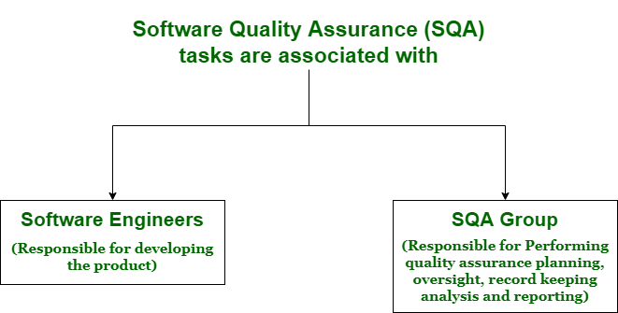

Slide 164
The elements comprising a development plan
1. Project products, specifying “deliverables”
2. Project interfaces
3. Project methodology and development tools
4. Software development standards and procedures
5. Map of the development process
6. Project milestones
7. Project staff organization
8. Required development facilities
9. Development risks and risk management actions
10. Control methods
11. Project cost estimates

Slide 165
Quality Plan
Quality plan Defines the Quality goals and activities performed to ensure the satisfaction of these goals.

Slide 166
Elements of a software quality plan
1. List of quality goals
2. Review activities
3. Software tests
4. Acceptance tests for software externally developed
5. Configuration management tools and procedures

Slide 167
Quality goals
Quality goals: Refers to the developed software quality requirements. The quality goals should reflect the major acceptance criteria indicated in the customer’s requirement document (i.e., the RFP document). As such, quality goals serve as measures of the successful achievement of the customer’s quality requirements.
The term “quality goals” refers to the developed software system’s substantive quality requirements. Quantitative measures are usually preferred to qualitative measures when choosing quality goals because they provide the developer with more objective assessments of software performance during the development process and system testing. However, one type of goal is not totally equivalent to the other.

Slide 168
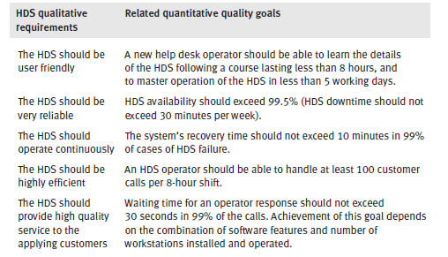
Quality goal example

Slide 169
2.Review activities
Planned review activities: A list of all SDLC activities and deliverables to be reviewed to ensure that quality meets requirements
The quality plan should provide a complete listing of all planned review activities: design reviews (DRs), design inspections, code inspections, and so on,
with the following determined for each activity:
■ The scope of the review activity
■ The type of the review activity
■ The schedule of review activities (as defined by its priority and the succeeding activities of the project process)
■ The specific procedures to be applied
■ Who is responsible for carrying out the review activity?

Slide 170
3. Software tests
Planned software tests : The quality plan should provide a complete list of planned software tests, with the following designated for each test
■ The unit, integration or the complete system to be tested
■ The type of testing activities to be carried out.
■ The planned test schedule
■ The specific procedures to be applied
■ Who is responsible for carrying out the test.

Slide 171
4. Planned acceptance tests for externally developed software
A complete list of the acceptance tests planned for externally developed software should be provided within the quality plan. Items to be included are :
(a) purchased software
(b) software developed by subcontractors
(c) customer-supplied software.
The acceptance tests for externally developed software should parallel those used for internally developed software tests.

Slide 172
5. Configuration management
The quality plan should specify configuration management tools and procedures, including those change-control procedures meant to be applied throughout the project.

Slide 173
Your Project
As part of your course project you are required to create a software quality plan
Use the previous guidelines in the slides to prepare your software quality plan required in your project
Search the web for “Software quality Plan samples” to obtain several samples

Slide 174
The objectives of development and quality plans.
The plans’ objectives are to provide the basis for:
■ Scheduling development activities
■ Recruiting team members and allocating development facilities
■ Resolving development risks
■ Implementing required SQA activities
■ Providing management with needed data for project control.

Slide 175
The major software risk items.
Typical development risks are:
■ Technological gaps – lack of adequate and sufficient professional knowledge
■ Staff shortages
■ Interdependence on other organizations: suppliers, subcontractors, etc.

Slide 176
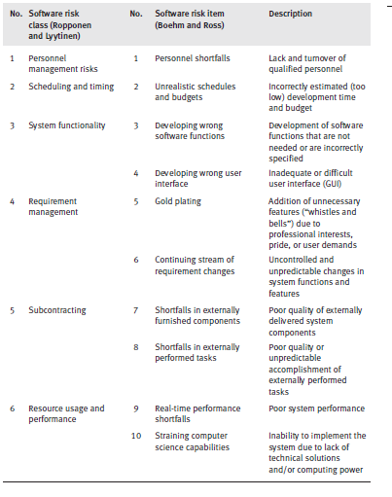

Slide 177
The process of software risk management.
The activities involved in risk management include planning, implementation, and
monitoring of implementation. The pertinent planning activities are identification of
SRIs, evaluation of those SRIs, and planning RMAs to resolve the SRIs.

Slide 178
The benefits of preparing development and quality plans for small projects
For small development projects (of not less than 15 man-days), preparation of development and quality plans is optional. However, one should consider the substantial advantages obtained by the plan’s developer. The main advantages of plan preparation are improvements in the developer’s understanding of the task, and greater commitment to complete the project as planned. In addition, the plan documents contribute to a better understanding between the developer and the customer, and easier and more effective project control.

Slide 179
the benefits of preparing development and quality plans for internal projects.
It is recommended that internal projects, undertaken on behalf of other departments and for development of software packages geared toward the market, be treated as “regular projects”. This implies that full-scale development and quality plans are to be prepared. Their benefits include:
The development department
will avoid losses incurred by unrealistic timetables and budgets, as well as the consequent damage to other projects and to the firm’s reputation.
(b) The internal “customer”
will enjoy reduced risk of late completion and budget overruns in addition to and by improved project control and coordination with
the developer.
(c) The firm
will enjoy reduced risk of its software product’s late entry into the market,
reduced risk of a decline in its reputation resulting from late supply, and
reduced risk of budget overruns.

Slide 180
Quality Control and Quality assurance
Quality control is designed to:
detect and correct defects,
whereas quality assurance is oriented toward:
preventing them.
Quality assurance is a managerial function that prevents problems by heading them off, and by advising restraint and redirection.

Slide 181
Quality Control
Quality control consists of well-defined checks on a product that are specified in the product quality plan.
For software products, quality control typically includes specification reviews, inspections of code and documents, and checks for user deliverables.

Slide 182
Quality Control
Quality control is defined as the processes and methods used to monitor work and observe whether requirements are met. It focuses on reviews and removal of defects before shipment of products.
This involves checking the software development process to ensure that procedures and standards are being followed.
Automated software assessment and software measurement.

Slide 183
Quality Control
Quality control is usually performed using two methods.
Reviews of documents such as requirements documents and design documents.
And testing of code and modules

Slide 184
Reviews
This is the principal method of validating the quality of a process or of a product.
A group of people carefully examine part or all of a software system and its associated documentation to find potential problems.
Code, designs, specifications, test plans, standards, etc. can all be reviewed.
Software or documents may be 'signed off' at a review which signifies that progress to the next development stage has been approved by management.

Slide 185
Some common
reviews
DPR – Development Plan Review
SRSR – Software Requirement Specification Review
PDR – Preliminary Design Review
DDR – Detailed Design Review
DBDR – Data Base Design Review
TPR – Test Plan Review
STPR – Software Test Procedure Review
VDR – Version Description Review
OMR – Operator Manual Review
SMR – Support Manual Review
TRR – Test Readiness Review
PRR – Product Release Review
IPR – Installation Plan Review

Slide 186
Quality Control Review types
The main technique for achieving quality control is the software checklist, walkthrough and inspection.
These are different types of reviews
Walkthrough is an informal review performed by peers. It need no prior preparation.
Checklists are list of items that should be checked during the review.

Slide 187
Walkthrough
In Walkthrough a piece of work is given to one or more colleague
They review that work and give their comments in order to enhance the job
Comments are usually in terms of problems detected or suggestions for further improvement
Walkthrough is informal and hence these comments might not be made

Slide 188
Inspection
Inspection is the most formal review type
In an inspection a piece of document is given to group of inspector in advance with the specific intent of finding errors in it.
The inspection group usually includes:
Moderator - leads the inspection, schedules meetings, controls the meetings, reports inspection results, and follows up on rework issues. each

Slide 189
Inspection
Author - created or maintains the work product being inspected. The author may answer questions asked about the product during the inspection, and he also looks for defects. The author cannot serve as moderator, reader, or recorder.
Reader - describes the sections of the work product to the team as they proceed through the inspection. The reader may paraphrase what is happening in the product, such as describing what a section of code is supposed to do, but he does not usually read the product verbatim.
Inspector - attempts to find errors in the product. All participants actually are acting as inspectors, in addition to any other responsibilities.

Slide 190
Inspection and walkthrough
Inspections and walkthroughs are primarily intended to discover defects in software code or documentation..
Inspections and walkthrough can be held a various points in development process.
Inspections and walkthrough have proven to be very successful tools for improving software quality

Slide 191
Checklists
Check lists are useful to support reviews, inspections, walkthroughs
Expertise is captured in a list format
Less experienced people can use
Straightforward to use (each check should be clear, simple to assess/apply)
Improve consistency of assessments

Slide 192
Quality Control walkthrough and Checklist
Inspection is a formal type of review. It requires preparation on the part the review team members before the inspection meeting takes place. A follow- up stage is also a requirement of the inspection. This ensures that any re-working is carried out correctly.

Slide 193
Quality Control Checklist for reviewing java code
Check list for java code:
are any while or if conditions closed with semicolon “;” ?
are all variables declared ?
does every ‘‘{’’ have a matching ‘‘}’’?
does every equality comparison have a double ‘‘=’’?

Slide 194
Quality Control Checklist for reviewing software design
Check list for reviewing software design:
Are all significant functions shown in design?
Are all significant attributes specified in design?
Are all names related to purpose and type and are they unambiguous?
Are all relationships between classes specified?
Do all functions have the data necessary for the function to execute?

Slide 195
Software Quality assurance (SQA) SWE 333
Software Quality Metrics

Slide 196
If you can’t measure it, you can’t manage it Tom DeMarco, 1982

Slide 197
Measurement, Measures, Metrics
Measurement
is the act of obtaining a measure
Measure
provides a quantitative indication of the size of some product or process attribute, E.g., Number of errors
Metric
is a quantitative measure of the degree to which a system, component, or process possesses a given attribute (IEEE Software Engineering Standards 1993) : Software Quality - E.g., Number of errors found per person hours expended

Slide 198
What to measure
Process
Measure the efficacy of processes. What works, what doesn't.
Project
Assess the status of projects. Track risk. Identify problem areas. Adjust work flow.
Product
Measure predefined product attributes

Slide 199
What to measure
Process
Measure the efficacy of processes. What works, what doesn't.
Code quality
Programmer productivity
Software engineer productivity
Requirements,
design,
testing
and all other tasks done by software engineers
Software
Maintainability
Usability
And all other quality factors
Management
Cost estimation
Schedule estimation, Duration, time
Staffing

Slide 200
Process Metrics
Process metrics are measures of the software development process, such as
Overall development time
Type of methodology used
Process metrics are collected across all projects and over long periods of time.
Their intent is to provide indicators that lead to long-term software process improvement.

Slide 201
Project Metrics
Project Metrics are the measures of Software Project and are used to monitor and control the project. Project metrics usually show how project manager is able to estimate schedule and cost
They enable a software project manager to:
Minimize the development time by making the adjustments necessary to avoid delays and potential problems and risks.
Assess product cost on an ongoing basis & modify the technical approach to improve cost estimation.

Slide 202
Product metrics
Product metrics are measures of the software product at any stage of its development, from requirements to installed system. Product metrics may measure:
How easy is the software to use
How easy is the user to maintain
The quality of software documentation
And more ..

Slide 203
Why do we measure?
Determine quality of piece of software or documentation
Determine the quality work of people such software engineers, programmers, database admin, and most importantly MANAGERS
Improve quality of a product/project/ process

Slide 204
Why Do We Measure?
To assess the benefits derived from new software engineering methods and tools
To close the gap of any problems (E.g training)
To help justify requests for new tools or additional training

Slide 205
Examples of Metrics Usage
Measure estimation skills of project managers (Schedule/ Budget)
Measure software engineers requirements/analysis/design skills
Measure Programmers work quality
Measure testing quality
And much more …

Slide 206
IEEE definitions of
software quality metrics
(1) A quantitative measure of the degree to which an item possesses a given quality attribute.
(2) A function whose inputs are software data and whose output is a single numerical value that can be interpreted as the degree to which the software possesses a given quality attribute.

Slide 207
Main objectives of
software quality metrics
1. Facilitate management control, planning and managerial intervention. Based on:
· Deviations of actual from planned performance.
· Deviations of actual timetable and budget performance from planned.
2. Identify situations for development or maintenance process improvement (preventive or corrective actions). Based on:
· Accumulation of metrics information regarding the performance of teams, units, etc.

Slide 208
Software size (volume) measures
KLOC — classic metric that measures the size of software by thousands of code lines.
Number of function points (NFP) — a measure of the development resources (human resources) required to develop a program, based on the functionality specified for the software system.

Slide 209
Process metrics categories
Process metrics categories
Software process quality metrics
Error density metrics
Error severity metrics
Software process timetable metrics
Software process error removal effectiveness metrics
Software process productivity metrics

Slide 210
Is KLOC enough ?
What about number of errors (error density)?
What about types of errors (error severity) ?
A mixture of KLOC, density, and severity is an ideal quality metric to programmers quality of work and performance

Slide 211
An example
2 different project programmers are working on two similar modules
Programmer A– produced 342 errors during software process before release
Programmer B- Produced 184 errors
Which Programmer do you think is better ?

Slide 212
An example
It really depends on the types of errors found (severity) and not only the number of errors (Density)
One error of high severity might be more important than hundreds of other types of errors

Slide 213
Error density metrics
Code | Name | Calculation formula
CED | Code Error Density | NCE CED = ----------- KLOC
DED | Development Error Density | NDE DED = ----------- KLOC
WCED | Weighted Code Error Density | WCE WCDE = --------- KLOC
WDED | Weighted Development Error Density | WDE WDED = --------- KLOC
WCEF | Weighted Code Errors per Function Point | WCE WCEF = ---------- NFP
WDEF | Weighted Development Errors per Function Point | WDE WDEF = ---------- NFP
NCE = The number of code errors detected by code inspections and testing.
NDE = total number of development (design and code) errors) detected in the development process.
WCE = weighted total code errors detected by code inspections and testing.
WDE = total weighted development (design and code) errors detected in development process.

Slide 214
Error severity metrics
Code | Name | Calculation formula
ASCE | Average Severity of Code Errors | WCE ASCE = ----------- NCE
ASDE | Average Severity of Development Errors | WDE ASDE = ----------- NDE
NCE = The number of code errors detected by code inspections and testing.
NDE = total number of development (design and code) errors detected in the development process.
WCE = weighted total code errors detected by code inspections and testing.
WDE = total weighted development (design and code) errors detected in development process.

Slide 215
Software process
timetable metrics
Code | Name | Calculation formula
TTO | Time Table Observance | MSOT TTO = ----------- MS
ADMC | Average Delay of Milestone Completion | TCDAM ADMC = ----------- MS
MSOT = Milestones completed on time.
MS = Total number of milestones.
TCDAM = Total Completion Delays (days, weeks, etc.) for all milestones.

Slide 216
Time Table Metric Example
TTO
Milestones are Requirements, Analysis, Design, Implementation, and Testing
Milestones completed in time are Requirements and analysis only
TTO = 2/5

Slide 217
Time Table Metric Example
ADMC
Requirements (One week delay, Analysis (Three weeks delay, Design (Two weeks delay, Implementation (Six weeks delay), and Testing (Two weeks delay)
Total Delay is 14 Weeks
ADMS = 14/5

Slide 218
Error removal
effectiveness metrics
Code | Name | Calculation formula
DERE | Development Errors Removal Effectiveness | NDE DERE = ---------------- NDE + NYF
DWERE | Development Weighted Errors Removal Effectiveness | WDE DWERE = ------------------ WDE+WYF
NDE = total number of development (design and code) errors) detected in the development process.
WCE = weighted total code errors detected by code inspections and testing.
WDE = total weighted development (design and code) errors detected in development process.
NYF = number software failures detected during a year of maintenance service.
WYF = weighted number of software failures detected during a year of maintenance service.

Slide 219
Error removal effectiveness metrics
DERE
Number of errors detected at design and coding stages is 100
Number of errors detected after one year of maintenance service is 500
DERE= 100/(100+500)

Slide 220
Process productivity
metrics
Code | Name | Calculation formula
DevP | Development Productivity | DevH DevP = ---------- KLOC
FDevP | Function point Development Productivity | DevH FDevP = ---------- NFP
CRe | Code Reuse | ReKLOC Cre = -------------- KLOC
DocRe | Documentation Reuse | ReDoc DocRe = ----------- NDoc
DevH = Total working hours invested in the development of the software system.
ReKLOC = Number of thousands of reused lines of code.
ReDoc = Number of reused pages of documentation.
NDoc = Number of pages of documentation.

Slide 221
Product metrics
categories
* Help Desk (HD) quality metrics:
* HD calls density metrics - measured by the number of calls.
* HD calls severity metrics - the severity of the HD issues raised.
* HD success metrics – the level of success in responding to HD calls.
* HD productivity metrics.
* HD effectiveness metrics.
* Corrective maintenance quality metrics.
* Software system failures density metrics
* Software system failures severity metrics
* Failures of maintenance services metrics
* Software system availability metrics
* Corrective maintenance productivity and effectiveness metrics.

Slide 222
HD calls density metrics
Code | Name | Calculation Formula
HDD | HD calls density | NHYC HDD = -------------- KLMC
WHDD | Weighted HD calls density | WHYC WHYC = ------------ KLMC
WHDF | Weighted HD calls per function point | WHYC WHDF = ------------ NMFP
NHYC = the number of HD calls during a year of service.
KLMC = Thousands of lines of maintained software code.
WHYC = weighted HD calls received during one year of service.
NMFP = number of function points to be maintained.

Slide 223
Severity of HD calls metrics
Code | Name | Calculation Formula
ASHC | Average severity of HD calls | WHYC ASHC = -------------- NHYC
NHYC = the number of HD calls during a year of service.
WHYC = weighted HD calls received during one year of service.

Slide 224
HD success metrics
Code | Name | Calculation Formula
HDS | HD service success | NHYOT HDS = -------------- NHYC
NHYNOT = Number of yearly HD calls completed on time during one year of service.
NHYC = the number of HD calls during a year of service.

Slide 225
HD productivity and
effectiveness metrics
Code | Name | Calculation Formula
HDP | HD Productivity | HDYH HDP= -------------- KLNC
FHDP | Function Point HD Productivity | HDYH FHDP = ---------- NMFP
HDE | HD effectiveness | HDYH HDE = -------------- NHYC
HDYH = Total yearly working hours invested in HD servicing of the software system.
KLMC = Thousands of lines of maintained software code.
NMFP = number of function points to be maintained.
NHYC = the number of HD calls during a year of service.

Slide 226
Software system
failures density metrics
Code | Name | Calculation Formula
SSFD | Software System Failure Density | NYF SSFD = -------------- KLMC
WSSFD | Weighted Software System Failure Density | WYF WFFFD = --------- KLMC
WSSFF | Weighted Software System Failures per Function point | WYF WSSFF = ---------- NMFP
NYF = number of software failures detected during a year of maintenance service.
WYF = weighted number of yearly software failures detected during one year of maintenance service.
NMFP = number of function points designated for the maintained software.
KLMC = Thousands of lines of maintained software code.

Slide 227
Failures of maintenance
services metrics
Code | Name | Calculation Formula
MRepF | Maintenance Repeated repair Failure metric - | RepYF MRepF = -------------- NYF
NYF = number of software failures detected during a year of maintenance service.
RepYF = Number of repeated software failure calls (service failures).

Slide 228
Software system
availability metrics
Code | Name | Calculation Formula
FA | Full Availability | NYSerH - NYFH FA = ----------------------- NYSerH
VitA | Vital Availability | NYSerH - NYVitFH VitA = ----------------------------- NYSerH
TUA | Total Unavailability | NYTFH TUA = ------------ NYSerH
NYSerH = Number of hours software system is in service during one year.
NYFH = Number of hours where at least one function is unavailable (failed) during one year, including total failure of the software system.
NYVitFH = Number of hours when at least one vital function is unavailable (failed) during one year, including total failure of the software system.
NYTFH = Number of hours of total failure (all system functions failed) during one year.
NYFH ≥ NYVitFH ≥ NYTFH.
1 – TUA ≥ VitA ≥FA

Slide 229
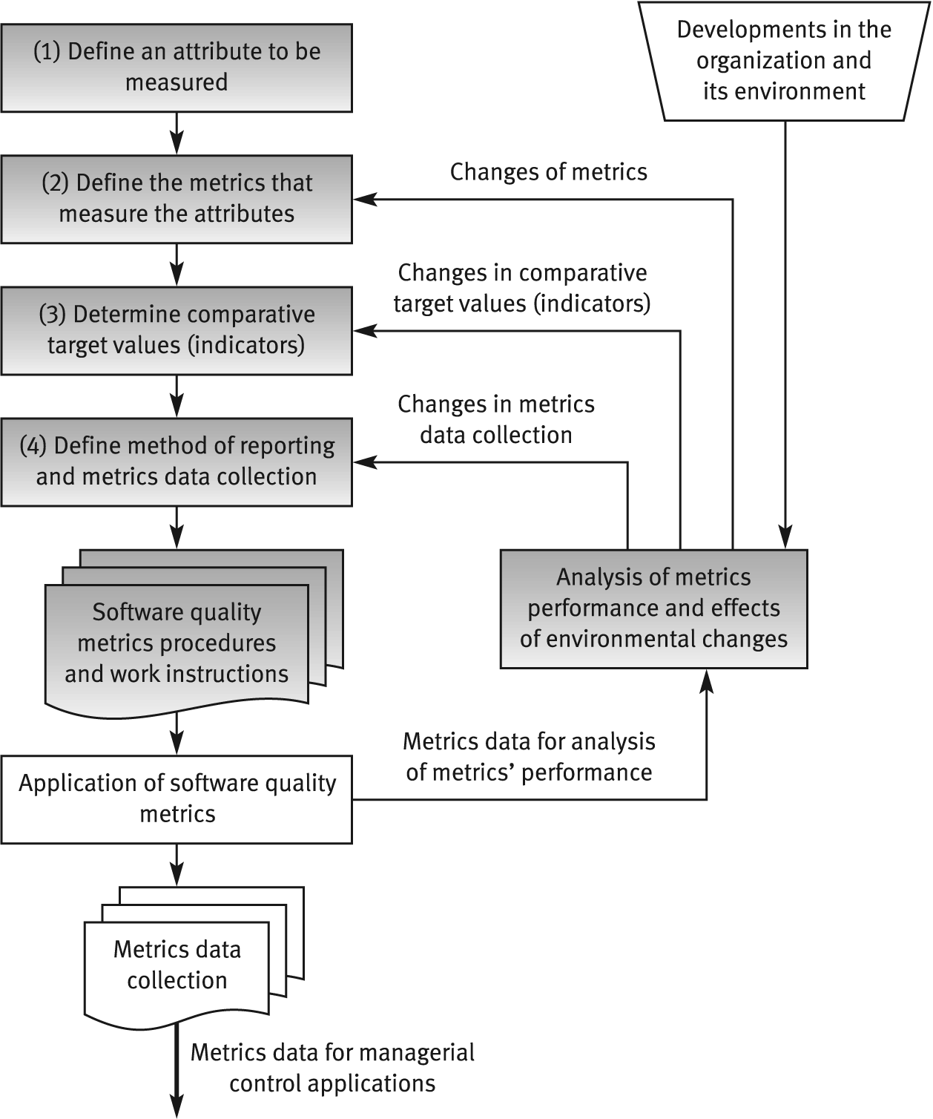
The process of
defining software quality metrics

Slide 230
General limitations of
quality metrics
* Budget constraints in allocating the necessary resources.
* Human factors, especially opposition of employees to evaluation of their activities.
* Validity Uncertainty regarding the data's, partial and biased reporting.

Slide 231
Examples of metrics
Requirements
Number of requirements that change during the rest of the software development process
if a large number changed during specification, design, …, something is wrong in the requirements phase and the quality of requirements engineers work
The less changes of requirements, the better requirements document quality

Slide 232
Examples of metrics
Inspection
number of faults found during inspection can be used as a metric to the quality of inspection process

Slide 233
Examples of metrics
Testing
Number of test cases executed
Number of bugs found per thousand of code
And more possible metrics

Slide 234
Examples of metrics
Maintainability metrics
Total number of faults reported
classifications by severity, fault type
status of fault reports (reported/fixed)
Detection and correction times

Slide 235
Examples of metrics
Reliability quality factor
Count of number of system failure (System down)
Total of minutes/hours per week or month

Slide 236
An example
Two Programmers produced 3 KLOC per day
After inspection, we found 100 low severity error, 20 medium severity errors and 10 High severity errors in the code of Programmer 1
And 300 low severity error, 10 medium severity errors and 2 High severity errors in the code of Programmer 2
Which programmer has the highest code quality ?
Programmers productivity using error severity and density
We will consider error density and error severity
Assume that we have three levels of severity
Low severity errors Wight is 1
Medium Severity Error Wight is 3
High Severity Error Wight is 15

Slide 237
Other Metrics
Understanding
Learning time: Time for new user to gain basic understanding of features of the software
Ease of learning
Learning time: Time for new user to learn how to perform basic functions of the software
Operability
Operation time: Time required for a user to perform operation(s) of the software
Usability
Human factors: Number of negative comments from new users regarding ergonomics, human factors, etc.

Slide 238
Other Metrics
Number and type of defects found during requirements, design, code, and test inspections
Number of pages of documentation delivered
Number of new source lines of code created
Number of source lines of code delivered
Total number or source lines of code delivered
Average complexity of all modules delivered
Average size of modules
Total number of modules
Total number of bugs found as a result of unit testing
Total number of bugs found as a result of integration testing
Total number of bugs found as a result of validation testing
Productivity, as measured by KLOC per person-hour

Slide 239
Examples..continued
Metrics for the analysis model
Metrics for the design model
Metrics for the source code
Average find-fix cycle time
Number of person-hours per inspection
Number of person-hours per KLOC
Average number of defects found per inspection

Slide 240
Examples..continued
Average find-fix cycle time
Number of person-hours per inspection
Number of person-hours per KLOC
Average number of defects found per inspection
Number of defects found during inspections in each defect category
Average amount of rework time
Percentage of modules that were inspected

Slide 241
Exercise
How can you measure the quality of:
Project manager skills.
Requirements Document
Software development plan
User manuals
Programmer coding skills
Design specification

Slide 242
ADMC Exercise
An SDLC that consists of six phases
Requirements ( 3 weeks delay)
Analysis (2 weeks delay)
Logical design (0 weeks delay)
Physical design ( 4 weeks delay
Implementation (10 weeks delay)
Testing ( 6 weeks delay) ADMC ?

Slide 243
Software Quality assurance (SQA)
Costs of Software Quality

Slide 244
“Because the main language of corporate management was money, there emerged the concept of studying quality-related costs as a means of communication between the quality staff departments and the company managers.”

Slide 245
Why do we need Cost Model
Distribution of cost to different software quality assurance tasks
Analysis to the effect of cost model
Redistribution if necessary
Justification to top management

Slide 246
Why do we need Cost Model
More and more, commercial companies or public organizations are requiring economic evaluation of their quality assurance systems.
Cost of software quality may be viewed as another class of software quality metrics where financial values are used as the measuring tool.

Slide 247
Actual Cost of Software Quality
Total Software
Development
Project Cost
Established
Cost of
Software
Quality in
projects
“Good”
Project
“Not So Good”
Project
From 40 - 67 % of costs are for Software Quality!

Slide 248

Cost of Software Quality
In general – it enables management to achieve economic control over SQA activities and outcomes. The specific objectives are:
Control organization-initiated costs to prevent and detect software errors.
Evaluation of the economic damages of software failures as a basis for revising the SQA budget.
Evaluation of plans to increase or decrease of SQA activities or to invest in SQA infrastructure on the basis of past economic performance.
Cost of Quality: Software Quality Professional, March 1999
Notes:
4
7
IN this section, I emphasize that software QA stuff is HALF the cost of the WHOLE development effort. It is NOT something separate. It is at the heart of the whole process.
These numbers are historical actual costs.
The last one was a 3 year study of orgs going from level 1 to 3. Note that even in level 3 orgs, the total expenitures was as high a 40%. That means that their costs were fairly similar, but the payoff was in lower defects.
…the whole point is that if HALF of the budget is spent on this stuff, you’d think people would invest half their time and resources getting a handle on it.
…wishful thinking.

Slide 249
Cost of Software Quality
Based on Industry Experience -
Quality as a Percent of Development Costs
Software Quality: 40 - 67%
Cost of Quality: Software Quality Professional, March 1999
Notes:
4
7
IN this section, I emphasize that software QA stuff is HALF the cost of the WHOLE development effort. It is NOT something separate. It is at the heart of the whole process.
These numbers are historical actual costs.
The last one was a 3 year study of orgs going from level 1 to 3. Note that even in level 3 orgs, the total expenitures was as high a 40%. That means that their costs were fairly similar, but the payoff was in lower defects.
…the whole point is that if HALF of the budget is spent on this stuff, you’d think people would invest half their time and resources getting a handle on it.
…wishful thinking.

Slide 250
The classic model of cost of software quality
■ Costs of control include costs that are spent to prevent and detect software errors in order to reduce them to an accepted level.
■ Costs of failure of control include costs of failures that occurred because of failure to prevent and detect software errors.
Costs of Control
Costs of Software Quality
Costs of Failure of Control

Slide 251
The classic model of
cost of software quality
Prevention costs
Costs of Control costs
Appraisal costs
Cost of software quality
Internal failure costs
Costs of Failure of control costs
External failure costs

Slide 252
The classic model of cost of software quality
The model further subdivides these classes into subclasses:
■ Costs of control :
■ Prevention costs include investments in quality infrastructure and quality activities that are not directed to a specific project or system, being general to the organization.
■ Appraisal costs include the costs of activities performed for a specific project or software system for the purpose of detecting software errors. They are devoted to detection of software errors.
■ Costs of failure of control :
■ Internal failure costs include costs of correcting errors that have been detected by design reviews, software tests and acceptance tests (carried out by the customer) and completed before the software is installed at customer sites.
■ External failure costs include all costs of correcting failures detected by customers or the maintenance team after the software system has been installed.

Slide 253
Good and bad quality costs
Prevention and appraisal costs represent cost of achieving good quality
Internal and external costs represent cost of poor quality
Why ?

Slide 254
Good and bad quality costs
Reduce bad quality cost by investing in good quality cost
Increasing budget for prevention and appraisal costs should reduce the costs of internal and external costs
If this does not happen then there are problem

Slide 255
Example of good and bad quality
Step 0 | Step 1 | Step 2 | Step 4
Good Quality cost of zero riyals | Good Quality cost increased to 50,000 riyals | Good Quality cost increased to 100,000 riyals | Good Quality cost increased to 150,000 riyals
Bad quality costs of 1,000,000 Riyals | Bad quality costs decreased to 900,000 Riyals | Bad quality costs decreased to 700,000 Riyals | Bad quality costs decreased to 500,000 Riyals
Total cost of 1,000,000 | Total cost of 950,000 | Total cost of 800,000 | Total cost of 650,000

Slide 256
Prevention costs
a. Investments in development of SQA infrastructure
components
* Procedures and work instructions
* Support devices: templates, checklists etc
* Software configuration management system
* Software quality metrics
b. Regular implementation of SQA preventive activities:
∗ Instruction of new employees in SQA subjects
* Certification of employees
* Consultations on SQA issues to team leaders and others
c. Control of the SQA system through performance of:
* Internal quality reviews
* External quality audits
* Management quality reviews

Slide 257
Appraisal costs
(a) Costs of reviews:
∗ Formal design reviews (DRs)
∗ Peer reviews (inspections and walkthroughs)
∗ Expert reviews
(b) Costs of software testing:
∗ Unit, integration and software system tests
∗ Acceptance tests (carried out by customers)
(c) Costs of assuring quality of external participants

Slide 258
Internal failure costs
Internal failure costs
∗ Costs of redesign or design corrections subsequent to design review and test findings
∗ Costs of re-programming or correcting programs in response to test findings
* Costs of repeated design review and re- testing (regression tests)

Slide 259
External failure costs
Typical external failure costs cover:
∗ Resolution of customer complaints during the warranty period.
∗ Correction of software bugs detected during regular operation.
∗ Correction of software failures after the warranty period is over even if the correction is not covered by the warranty.
∗ Damages paid to customers in case of a severe software failure.
∗ Reimbursement of customer's purchase costs.
∗ Insurance against customer's claims.
Typical examples of hidden external failure costs:
∗ Reduction of sales to customers that suffered from software failures.
∗ Severe reduction of sales motivated by the firm's damaged reputation.
∗ Increased investment in sales promotion to counter the effects of past software failures.
* Reduced prospects to win a tender or, alternatively, the need to under-price to prevent competitors from winning tenders.

Slide 260
Application of a cost of
software quality system
* Definition of a cost of software quality model and specification of cost items.
* Definition of the method of data collection for each cost item.
* Application of a cost of software quality system, including thorough follow up.
* Actions taken in response to the findings.

Slide 261
Problems in the
application of cost of software
quality metrics
General problems
* Inaccurate and/or incomplete identification and classification of quality costs.
* Negligent reporting by team members
* Biased reporting of software costs, especially of “censored” internal and external costs.
* Biased recording of external failure costs - “camouflaged” compensation of customers for failures.
Problems arising when collecting data on managerial costs:
* Contract review and progress control activities are performed in a “part-time mode”. The reporting of time invested is usually inaccurate and often neglected.
* Many participants in these activities are senior staff members who are not required to report use of their time resources.
* Difficuties in determination of responsibility for schedule failures.
* Payment of overt and formal compensation usually occurs quite some time after the project is completed, and much too late for efficient application of the lessons learned.

